Slide 1
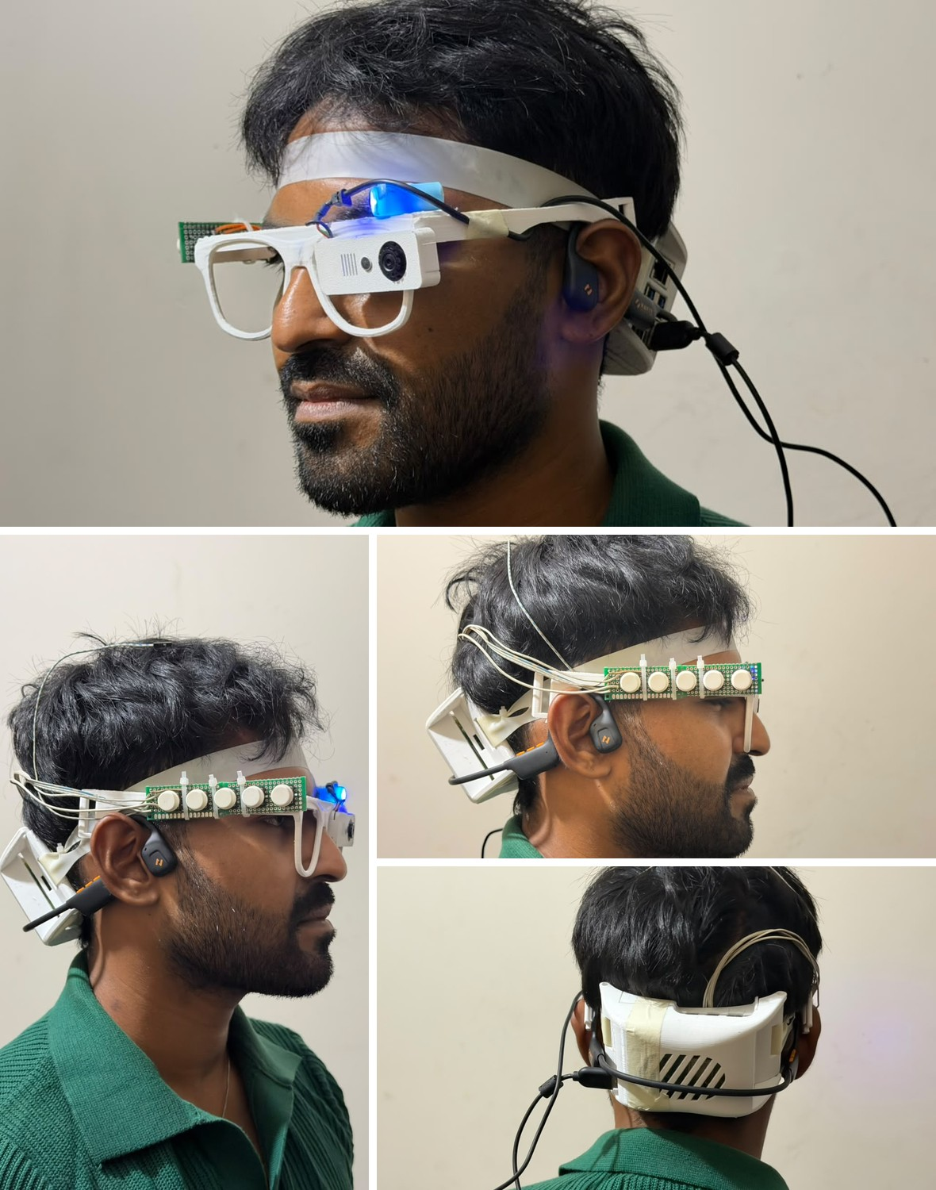

SARA
Smart Assistive Reading Aid: an offline smart glass that reads Bangla and English, names objects, and recognises and checks Bangladeshi Taka notes
MD Abdun Fattah Lam (2220014) · Mukut Protim Memo (2020086)
Tanjila Hossain Tapti (2130561)
Supervisor: Mohammad Shidujaman, PhD, Assistant Professor
Department of Computer Science and Engineering, Independent University, Bangladesh
Notes:
We present SARA, a smart glass for blind and low-vision people in Bangladesh. It reads Bangla and English text, names objects, recognises Taka notes and checks them carefully, and it works on the device without the internet. The photo is the current prototype.

Slide 2
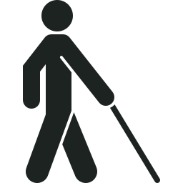

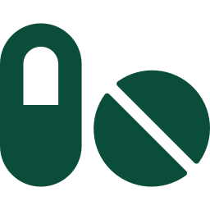

Three questions a blind person cannot answer alone
1 At the shop
2 At the pharmacy
3 On the street
Which note did I get back? Is it real?
What does this label say? When do I take it?
What is in front of me? Who is talking?
Must trust the shopkeeper's word
Labels are in Bangla; no device reads them
Must stop and ask a stranger
Every answer depends on another person, and the blind person cannot check it.
Notes:
Three everyday moments. At the shop, the blind customer receives change and must trust the shopkeeper about which note it is and whether it is real. At the pharmacy, the medicine label is in Bangla and no affordable device reads it. On the street, they must stop and ask a stranger what is ahead. In every case the answer comes from another person and cannot be checked.

Slide 3



Why existing help does not reach Bangladeshi users
Built for English
2.2 billion
Commercial reading glasses do not read Bangla or know Taka notes [2].
people worldwide have a near or distance vision impairment [1]
Need the internet
Research glasses send every picture to a cloud server [3, 4]: no network, no answer.
The burden falls most heavily on low- and middle-income regions [1]
Answers cannot be checked
A wrong note value or a false "counterfeit" costs money or causes an accusation.
Sources: [1] WHO 2023; [2] OrCam MyEye; [3] Ali A. et al., IEEE Access 2021; [4] Brilli et al., arXiv 2024.
Notes:
The World Health Organization counts at least 2.2 billion people with a vision impairment, most of them in low- and middle-income countries. Three gaps keep existing help away from Bangladeshi users: devices are built for English, research glasses need a cloud server, and a blind user cannot check the device's answer.

Slide 4
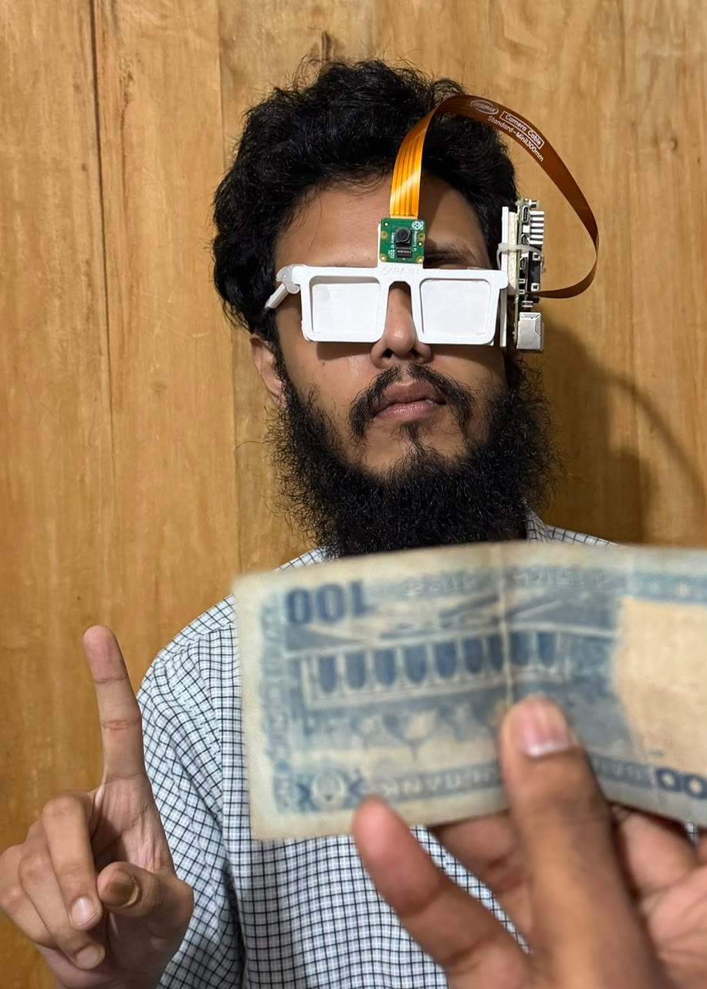



The same moment with SARA: ask the glass, not a stranger
1 The user speaks
"Glass, check money"
2 The glass looks
Camera picture → Taka detector on the Raspberry Pi 5, no internet
3 The glass answers in Bangla
একশত টাকার নোট "100 Taka note", and a short vibration
The same three steps read a medicine label ("glass, read text") or name what is ahead ("glass, objects").
Notes:
Here is the same moment with SARA. The user says glass, check money. The camera picture goes to the Taka detector on the Raspberry Pi, without the internet, and the glass answers in Bangla, one hundred Taka note, with a short vibration. The same steps read a medicine label or name objects ahead.

Slide 5
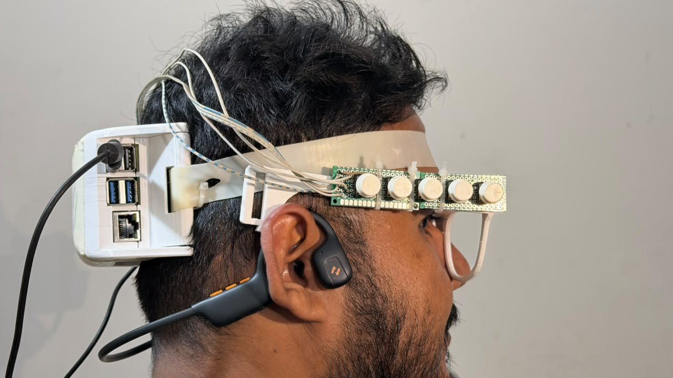




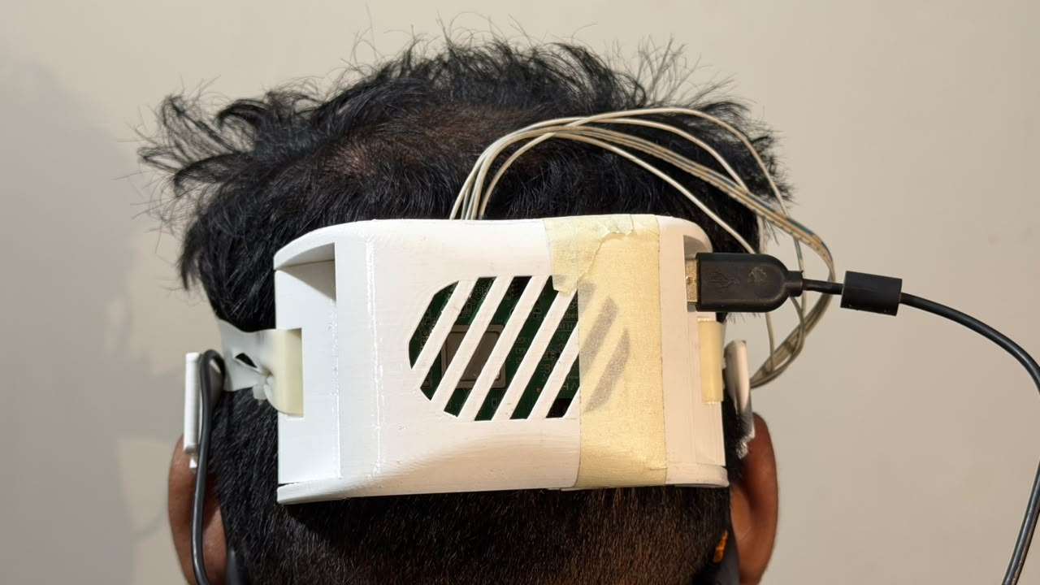

SARA at a glance: five modes, buttons or voice
Text reading
Objects
Bangla and English, read aloud
Names what is in front, in Bangla
Taka notes
Emotion
All nine notes + a careful counterfeit check
Facial expression of the person in front
Online description
Voice commands
Optional; the only mode needing internet
"Glass, read text", "glass, stop" ...
Notes:
This is the current prototype: the camera and five buttons sit on the frame, a bone-conduction earphone leaves the ears free, and the Raspberry Pi 5 rides in a ventilated enclosure at the back of the head. Five modes cover text, objects, Taka notes, emotion and an optional online description. Every mode can be started with a button or with a voice command that begins with the word glass.

Slide 6
Six research questions
1
System
2
Synthetic data
3
Number of views
Can a multi-function Bangla glass run on a Raspberry Pi 5, and how fast?
Can a Taka detector trained without hand labels work on real, hand-held photos?
Why do multi-view counterfeit models fail with fewer views, and can training fix it?
4
Unseen prints
5
Safety
6
Bangla OCR
How much does accuracy drop on counterfeit prints never seen in training?
Can the glass give counterfeit advice that never accuses a genuine note?
Which part of a Bangla OCR pipeline matters most for a wearable camera?
Notes:
Six questions organise the talk: the system on the Pi, synthetic training data for currency, the number of views, unseen counterfeit prints, a safe spoken verdict, and Bangla OCR.

Slide 7
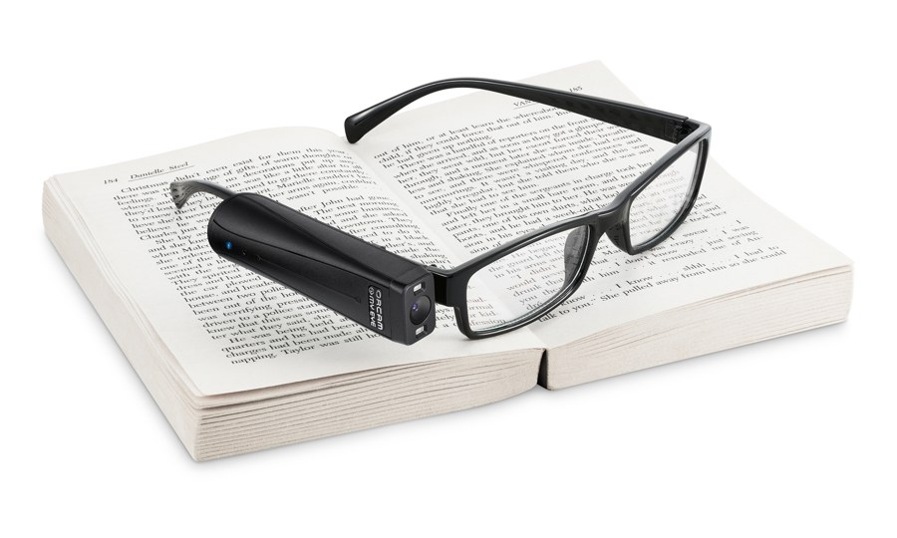
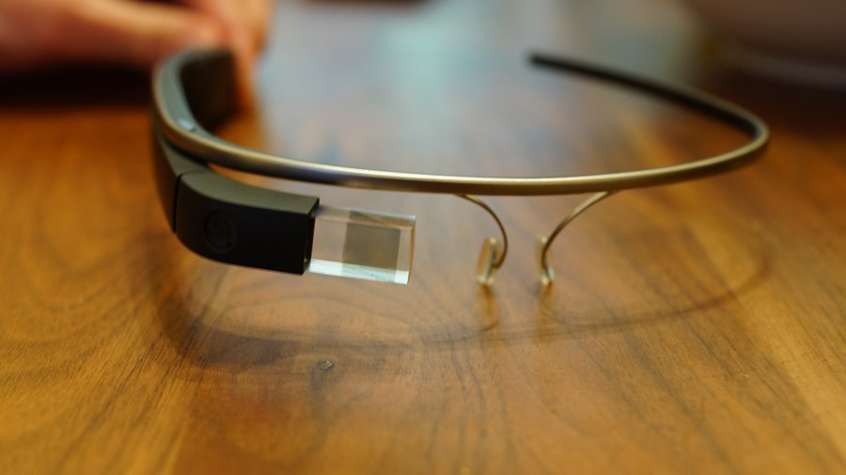
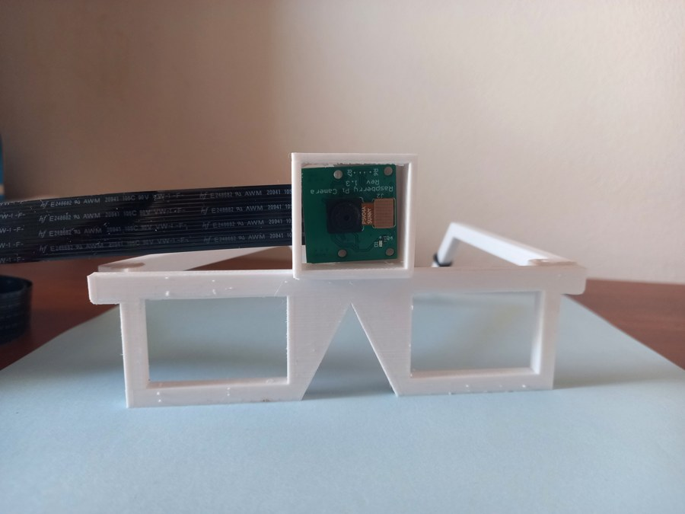
What existing devices miss
The gap
No device combines Bangla, Taka and offline use.
Counterfeit studies never check whether test notes are copies of prints seen in training.
Few prototypes report accuracy per feature or speed on the real device.
OrCam MyEye [2]
Google Glass analysis [3]
AIris [4]
System | Reads Bangla | Knows Taka | Works offline | Wearable
OrCam MyEye [2] | No | No | Yes | Yes
Google Glass scene analysis [3] | No | No | No | Yes
AIris (2024) [4] | No | No | No | Yes
Raspberry Pi reading aids | No | No | Partly | Partly
SARA (ours) | Yes | Yes | Yes | Yes
Photos: OrCam MyEye by Ylip, CC BY-SA 4.0; Google Glass by Ted Eytan, CC BY-SA 2.0 (Wikimedia Commons); AIris from [4]. Comparison from [2, 3, 4].
Notes:
Commercial glasses such as OrCam work offline but not in Bangla and not with Taka. Glass-based research systems send pictures to a server. Raspberry Pi reading aids are cheap but mostly English. No device combines Bangla, Taka and offline use, and counterfeit studies do not check for copies of the same print in training and test.

Slide 8


How the glass works
Text: CRAFT detector + EasyOCR recogniser [5, 6]
Objects: YOLOv8s, COCO classes [7, 8]
Camera 640×480
Raspberry Pi 5
mode manager
(all on the CPU)
Currency: YOLOv8s + safe counterfeit + watermark checks
Bangla / English speech + vibration [10, 11]
Emotion: YuNet face + EfficientNet, RAF-DB [9]
5 buttons
Online: Cloud vision model (optional)
Voice: "glass, …"
Sources: [5] Baek et al. 2019; [6] EasyOCR; [7] Ultralytics YOLOv8; [8] COCO; [9] RAF-DB; [10] Piper; [11] eSpeak NG.
Notes:
The camera picture, the buttons and voice commands go to a mode manager on the Raspberry Pi 5. The active mode runs its model on the CPU, and the result is spoken in Bangla or English, with a vibration for a detected note.

Slide 9
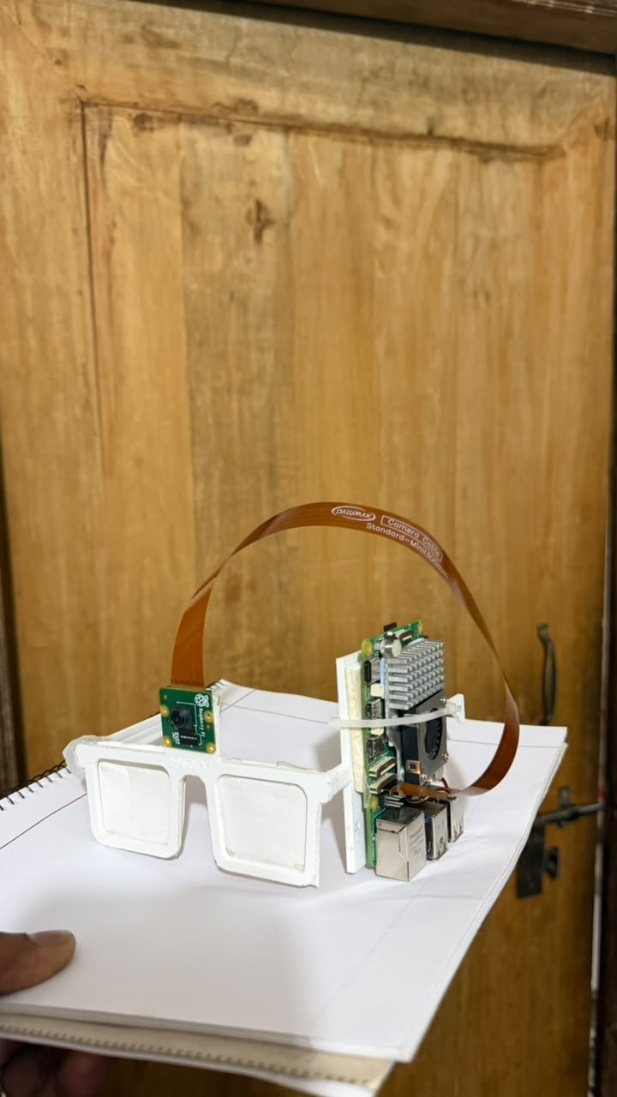
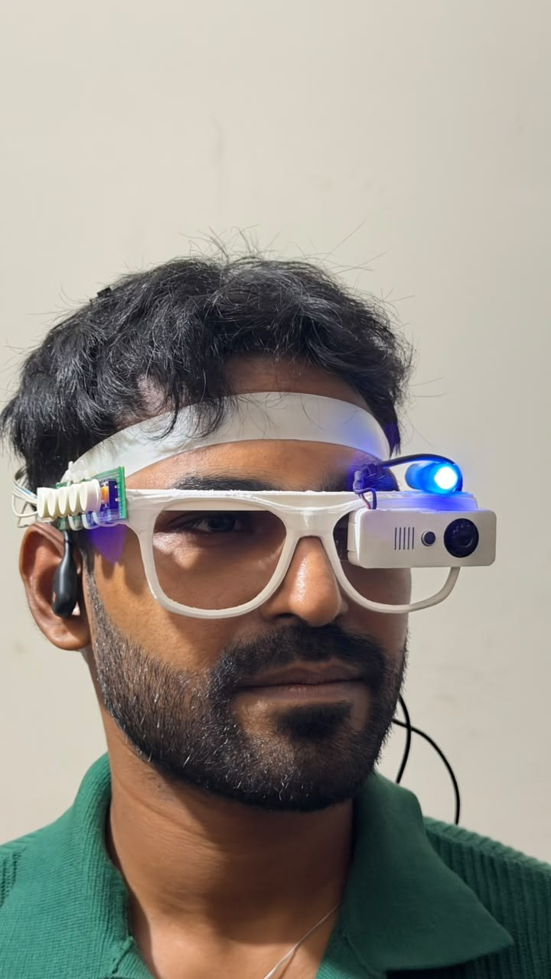
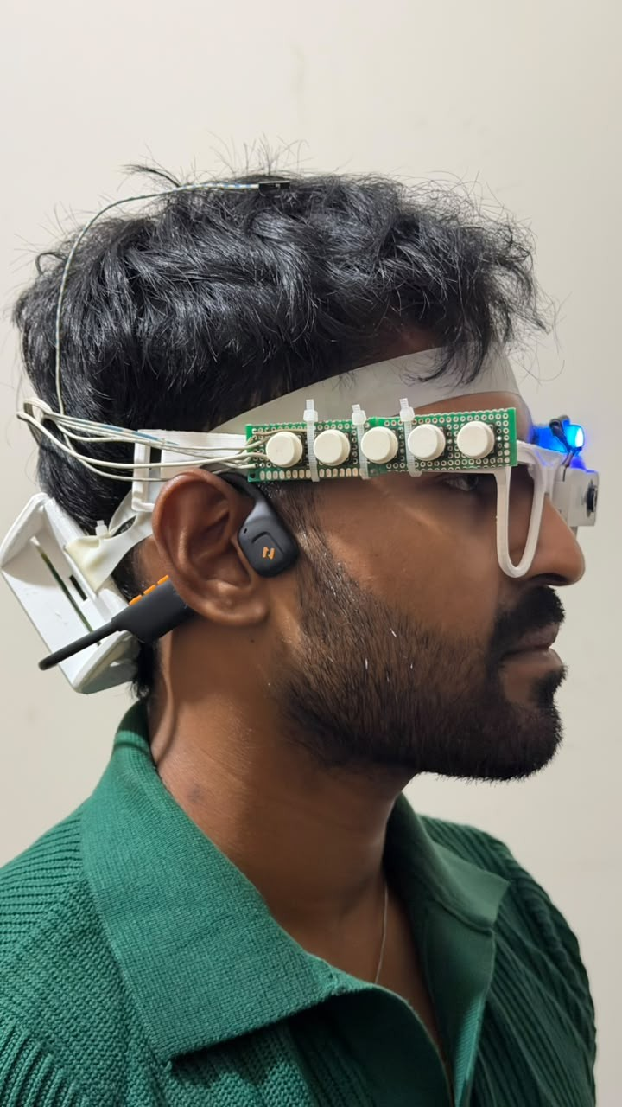
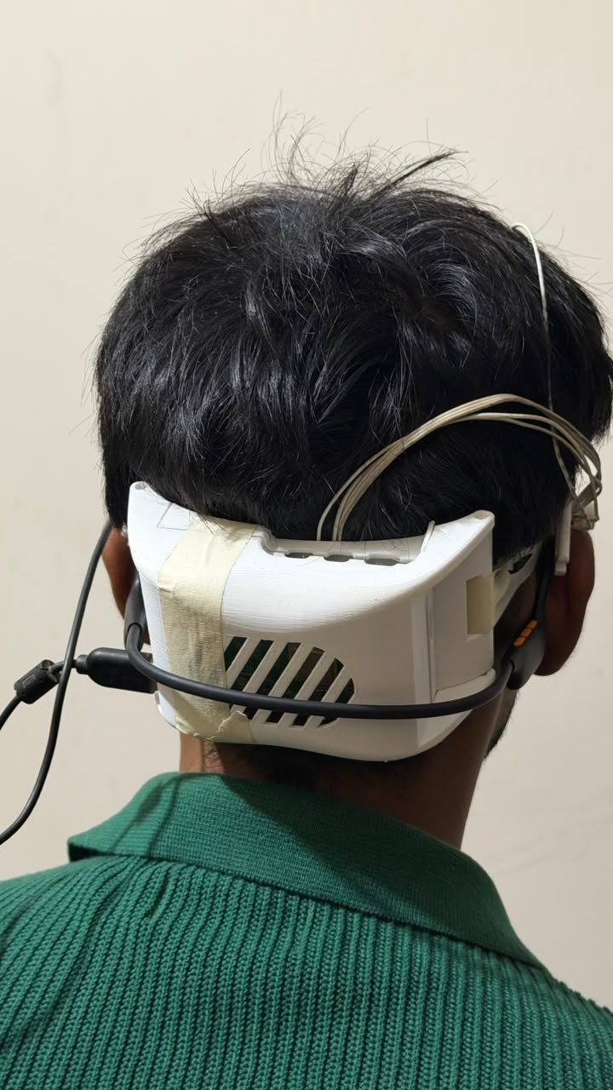
From a desk prototype to a wearable glass
Version 2
Version 1: board and fan on one temple
Front: camera and UV lamp (blue light)
Side: five buttons, bone-conduction earphone
Back: Pi 5 in a ventilated enclosure
Notes:
The first version put the board and fan on one temple: heavy on one side and loud by the ear. Version two moves the Raspberry Pi into a ventilated enclosure at the back of the head, keeps the camera and an LED on the bridge, puts five buttons along the frame and uses a bone-conduction earphone so the ears stay free for traffic sounds.

Slide 10
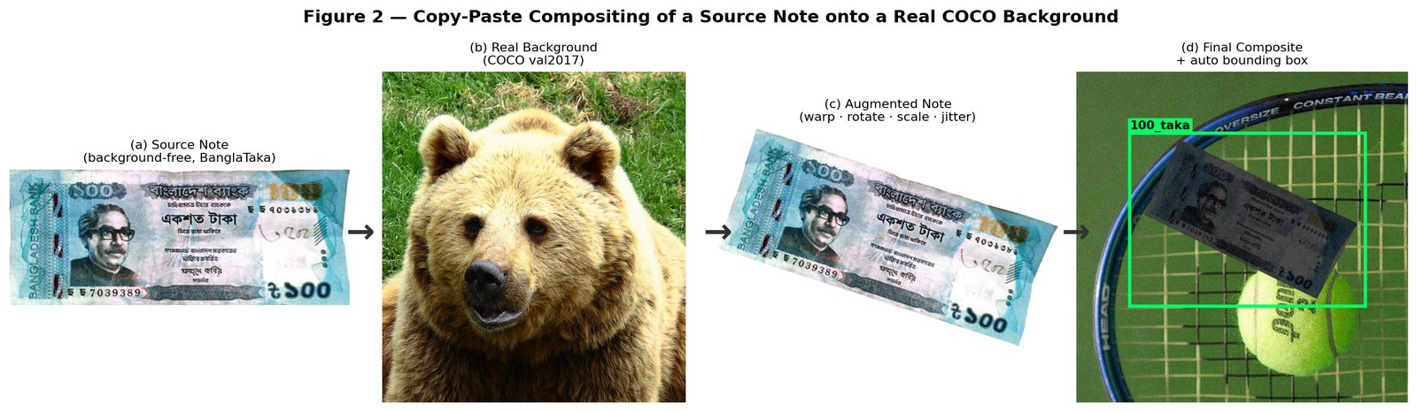
Taka detection: 22,333 training images, no hand labels
0.995
mAP@0.5 on 2,282 held-out composites
94.1%
5,073 note photos [12] are pasted onto real COCO pictures [8] with random angle, scale, light and blur; the program writes every box label itself.
right on 1,536 photos taken by other people
0
hand-drawn boxes needed
Sources: [12] BanglaTaka (Mendeley); [8] Lin et al., COCO, ECCV 2014; detector [7] Ultralytics YOLOv8. 94.1% with the hand-held detector (next slide).
Notes:
Public Taka images are clean close-ups, so a model trained on them fails on a live camera. We pasted the notes onto real photographs and let the program write the labels. The detector scores 0.995 mAP on held-out composites and names 94.1 percent of independent photographs correctly.

Slide 11
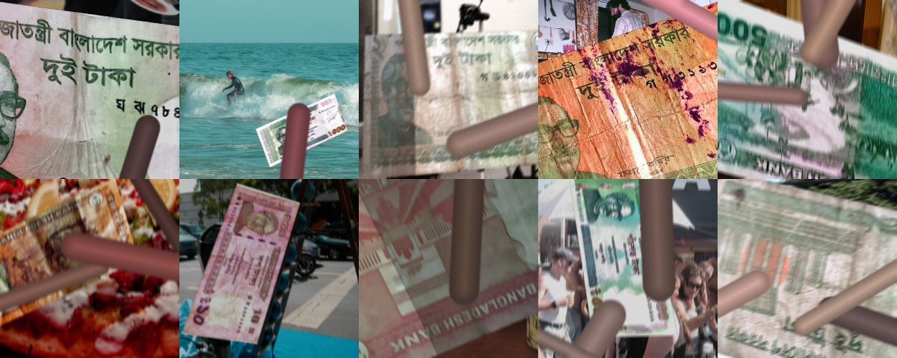
Notes held in a hand: from 1 in 8 to 1 in 2
6,000 synthetic close-ups: notes overflowing the frame, folded, turned, blurred, under fingers. Built from training notes only; epoch and threshold chosen on validation; test read once.
Costs, reported: one-taka notes named more often (36.6%); 3 notes in view: total right 97.0% (was 99.2%).
Sources: test photos [13] Rafi et al., NSTU-BDTAKA, Data in Brief 2024; detector [7] YOLOv8. Our results: paper_evidence/HANDHELD_FINETUNE.md.
Notes:
A blind user holds the note close, folded and under the fingers, and our training pictures showed whole notes in scenes. We generated six thousand hand-held close-ups from training notes only and fine-tuned the detector. On the independent NSTU hand-held test, the right value rises from 11.8 to 47.5 percent on the laptop and from 8.7 to 33.5 percent on the Pi. We report the costs too.

Slide 12
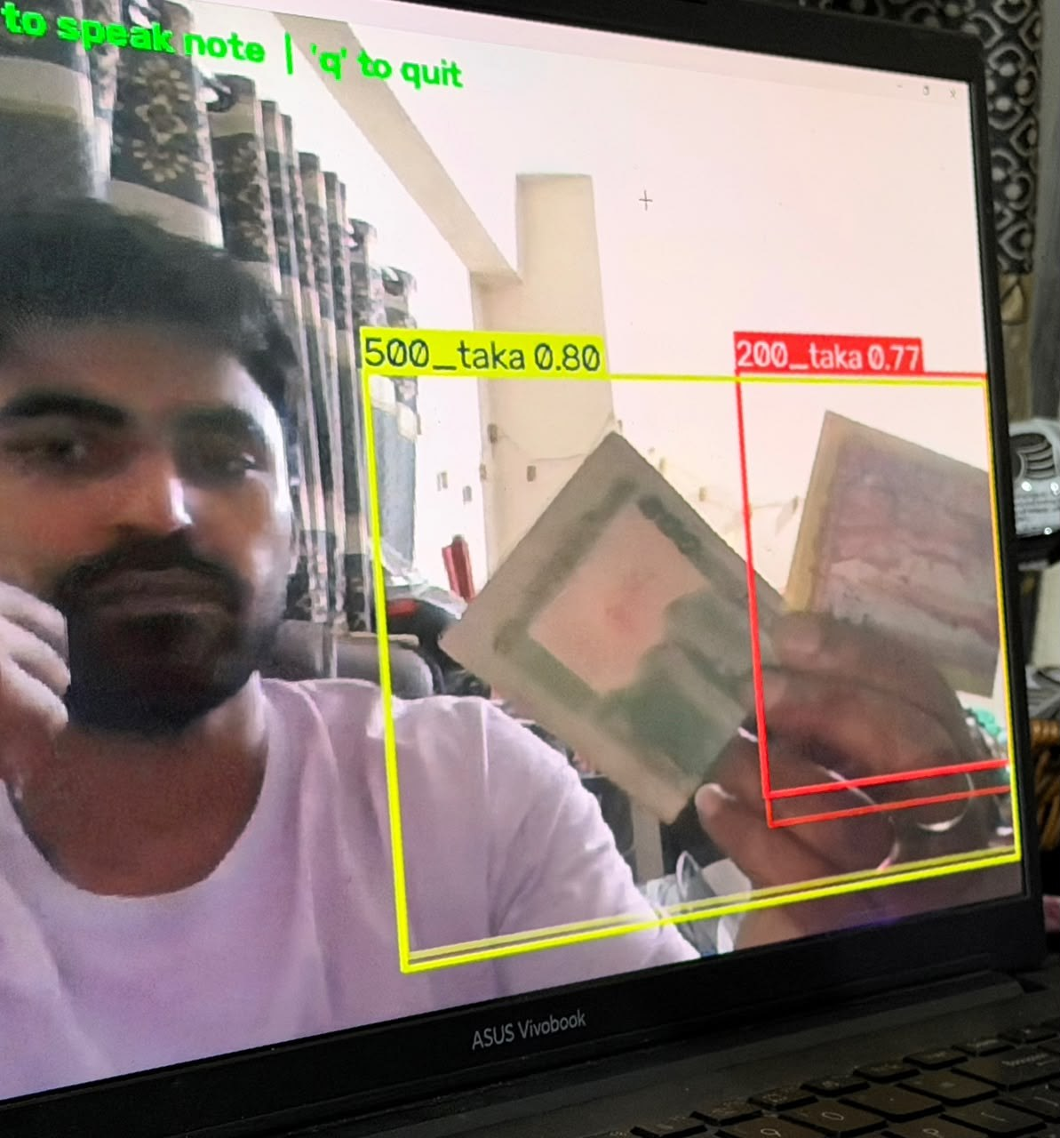
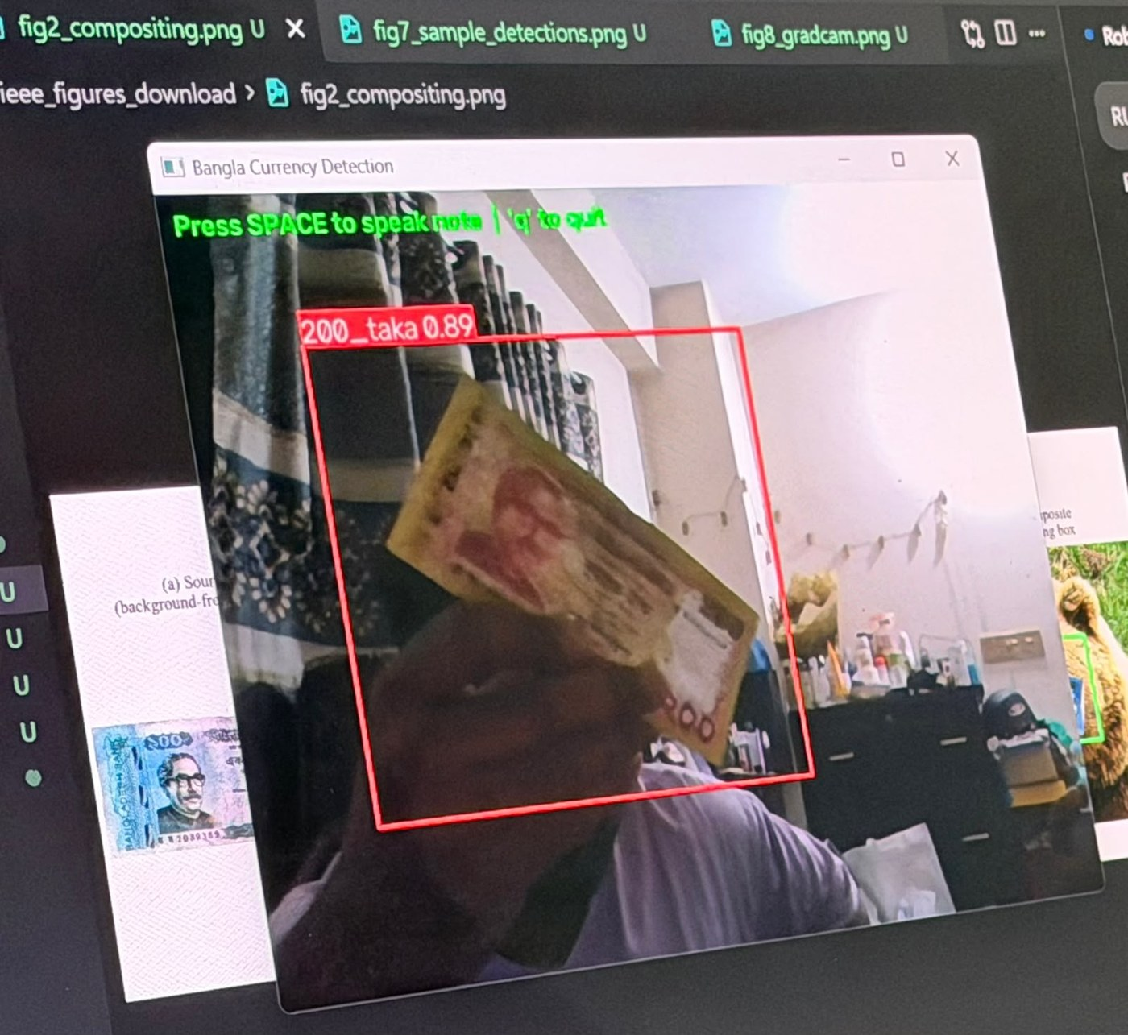
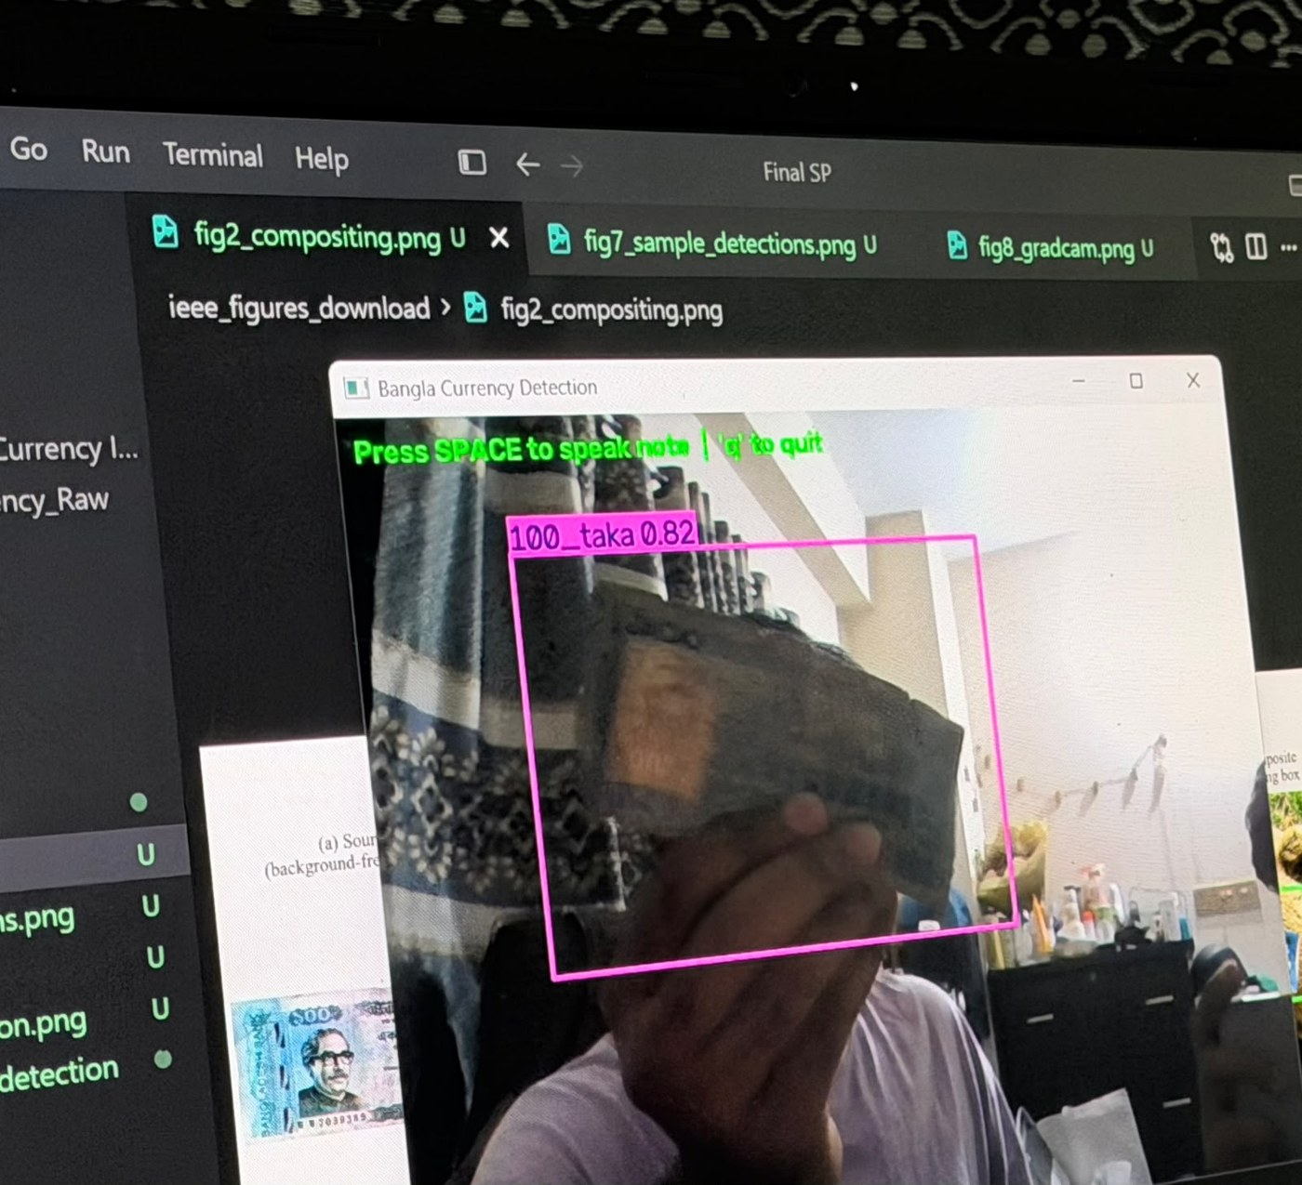
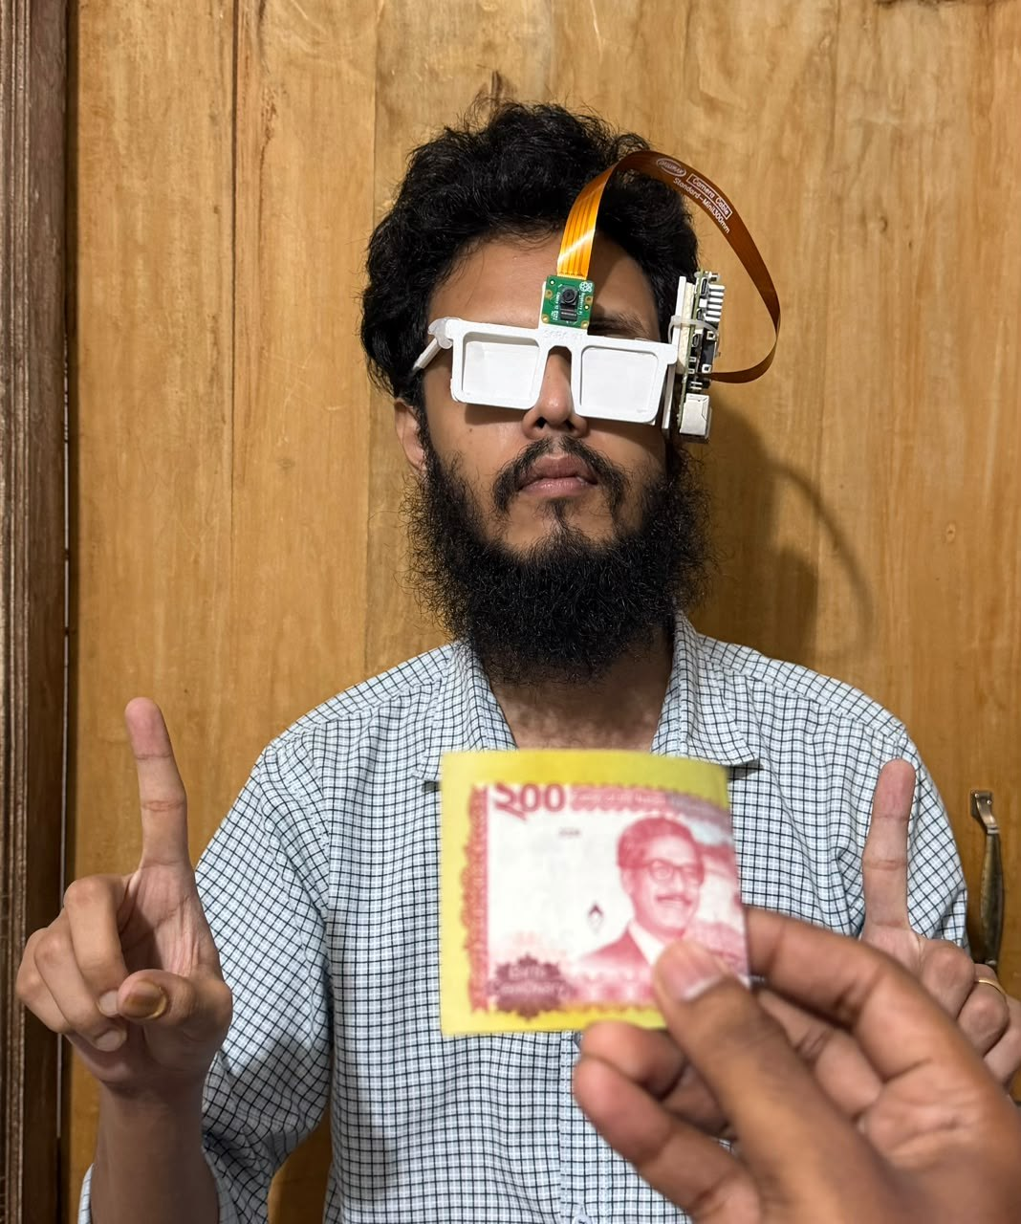
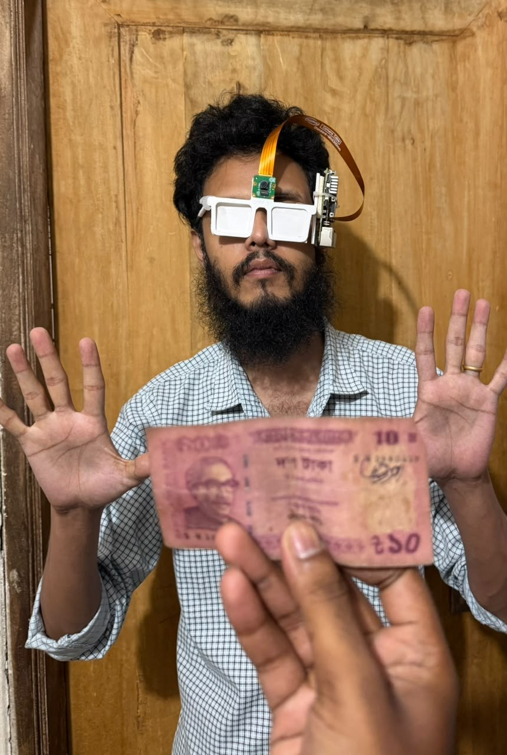
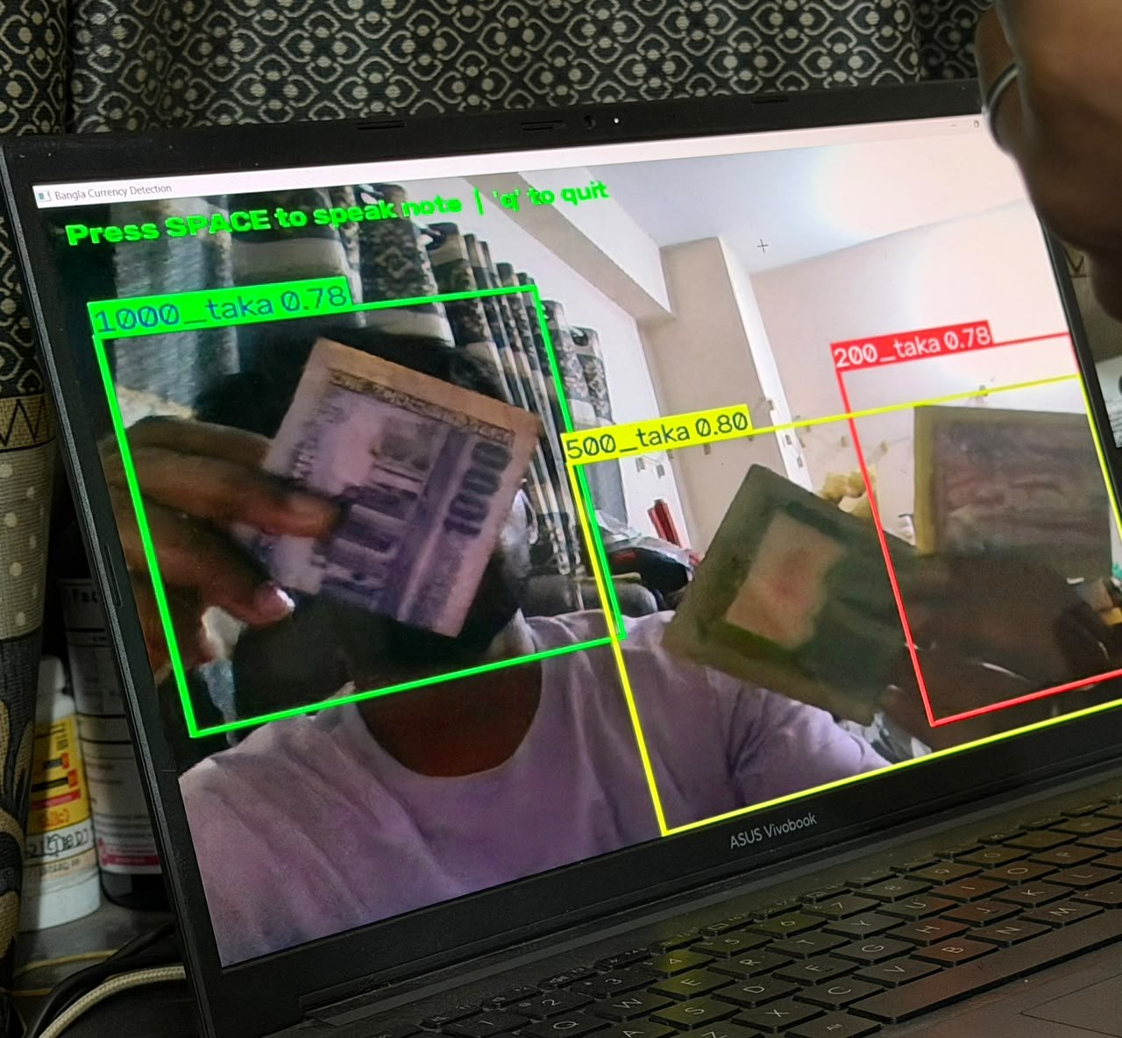
Live tests with real notes
10, 50, 100, 200, 500 and 1,000 Taka named at 0.63–0.89 confidence
Worn and folded notes, two or three notes at once
Boxes are loose and can overlap when notes are close
Informal sessions with a laptop webcam (top row, bottom right) and the first glass prototype (bottom left, centre); no error rate was counted.
Notes:
These are live sessions with our own notes: a laptop webcam on top and the first glass prototype below. They illustrate behaviour; we did not count an error rate in these sessions.

Slide 13
Counterfeit check: one view is enough with prefix training
71.2% → 98.2%
accuracy with a single view, JaalTaka test notes
A blind user cannot promise six views
Training on random first-k views removes the collapse
No loss at six views; stable across seeds
Data: [14, 15] Piyas et al., JaalTaka dataset and article, 2025-2026 (1,390 notes, six views each; counterfeits seized by the Rapid Action Battalion).
Notes:
A model trained only with all six views of a note collapses to 71 percent with one view. Training on random prefixes of the views keeps it at about 98 percent from one to six views.

Slide 14
Unseen counterfeit prints: a stricter test
279 of 322
readable 500 Taka counterfeits carry the same serial number
The usual split puts copies of one print in training and test; a serial lookup alone scores 90.2%. In our split every test counterfeit is a new print. The watermark check lifts accuracy to 95.0%.
Data: [14] JaalTaka; serial-number audit and print-disjoint split are ours. Earlier Taka counterfeit work: [16] SVM on security features; [17] CNNs; [19] UV flecks + RPN.
Notes:
Most counterfeit notes in JaalTaka are copies of a few prints, so the usual test measures recognition of known reprints. On truly unseen prints our network drops to about 89 percent; adding the watermark check brings it to 95 percent.

Slide 15
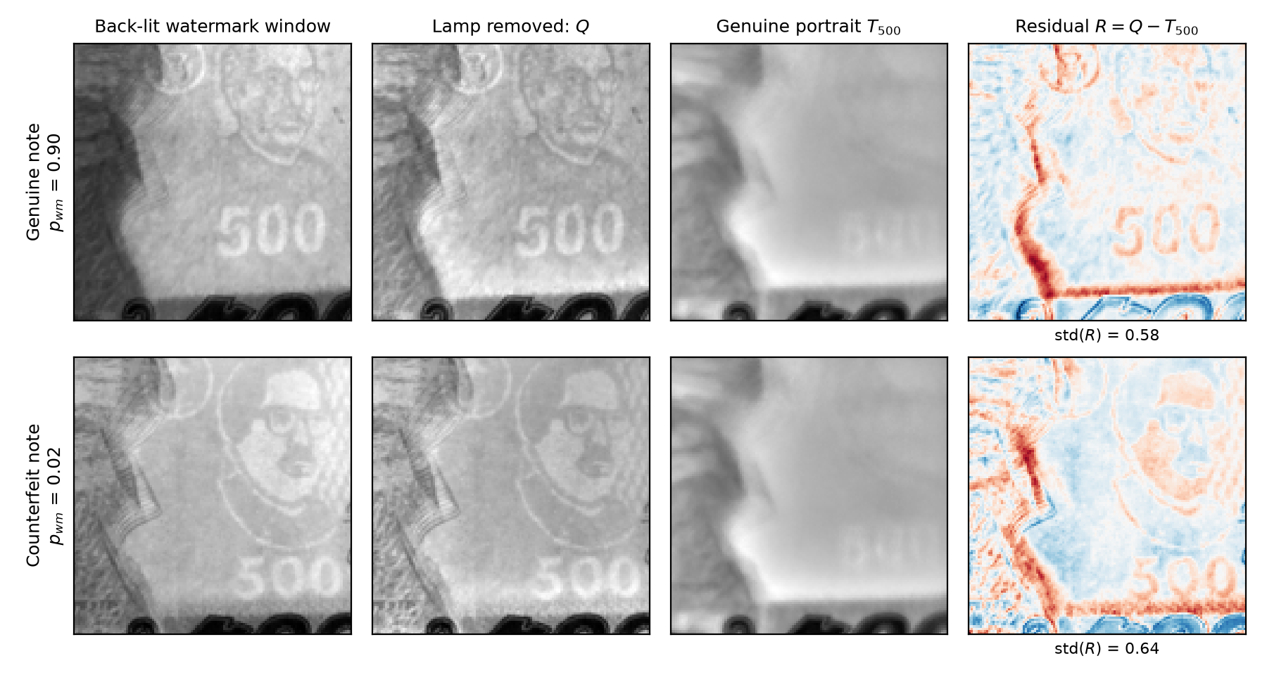
DMWR: a tiny, physics-based watermark checker
91.5%
on unseen counterfeit prints (3 seeds, ±0.3)
47,818
parameters (0.21 MB): 46× smaller than MobileNetV2 [18]
p ≥ 0.375
1. Remove the lamp: Q = I / (G∗I)
2. Genuine portrait: T = median of Q over genuine notes
3. Residual R = Q − T → two small CNN streams → "watermark clear?"
no significant difference from MobileNetV2 (92.9%)
Baseline [18] Sandler et al., MobileNetV2, CVPR 2018; data [14] JaalTaka. DMWR (denomination-matched watermark residual) is our method.
Notes:
Our watermark method divides the back-lit photo by a blurred copy to remove the lamp, subtracts a genuine portrait of the note value and classifies the residual with two tiny networks. With under fifty thousand parameters it reaches 91.5 percent on unseen prints, statistically level with a MobileNetV2 46 times larger.

Slide 16
Safe before decisive: the glass never says "counterfeit"
"Likely genuine"
0 / 88
Score above the safe threshold?
yes
test counterfeits passed as "likely genuine"
Note captured
no
"Check by hand" + guided watermark check
Threshold = highest score of any validation counterfeit, so a new counterfeit passes with probability 1/(n+1) ≈ 1.1%. 57.5% of genuine notes are confirmed from close-up views; otherwise the glass asks for a check by hand.
Test notes: [14] JaalTaka.
Notes:
Because a blind user cannot verify the answer, the glass never says a note is counterfeit. It says likely genuine only above a threshold set from validation counterfeits; otherwise it asks for a check by hand. No test counterfeit passed.

Slide 17
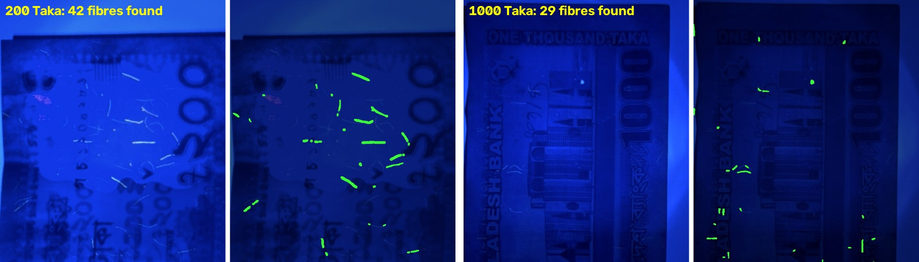
UV fibre check: the glass carries its own UV lamp
85.6%
88.6%
A prototype, off by default: no real counterfeit has been photographed under the lamp yet.
of 111 real UV photos of genuine notes accepted
of simulated fibre-free printed sheets rejected
The glass's lamp emits 360-395 nm, covering the 365 nm used for banknote checks; banknote paper stays dark while its fibres glow [20]. Prior Taka UV work: [19] (96.3%). Fibre check and photos are ours.
Notes:
Under a UV lamp, genuine 200, 500 and 1000 Taka notes show glowing security fibres. Our check removes the lamp's own blue light and counts thin glowing marks. It accepts 85.6 percent of real genuine photos and rejects 88.6 percent of simulated fibre-free sheets. It stays off by default until real counterfeits are tested.

Slide 18
Bangla reading: rendered text and real street photos
What helped
Reading only the main block of text
Tuned detector settings, CLAHE, clean-up rules
Recogniser fine-tuned on real words, blended 50/50 with the original weights
What did not
Binarisation, multi-scale reading, Tesseract, TrOCR, PaddleOCR, dictionaries, smaller pictures, rotation retry
Engine [6] EasyOCR with [5] CRAFT; real words from [21] ICDAR 2019 MLT (1,000 test words). Every choice made on validation data.
Notes:
On our rendered Bangla and English benchmark the error fell from 9.3 to 2.3 percent. Real street words are much harder: a recogniser fine-tuned on real words and blended with the original weights lowered the error from 39.2 to 28.7 percent for Bangla and from 62.5 to 50.6 percent for Latin script.

Slide 19
Voice: a natural Bangla voice and spoken commands
212 → 13
Speaking
false commands in 5,040 ordinary sentences, thanks to the wake word
Natural Piper voice for Bangla and English [10]; eSpeak NG as fallback [11]
Each sentence rendered before it plays: no broken sound when the Pi is busy
"পড়ছি" (reading) and a soft tick while a long capture runs
0.86 s
from the end of speech to the action (median)
Synthetic voices on a laptop; not yet people.
Recogniser [22] Vosk; noise from [23] Piczak, ESC-50; voices [10, 11]. Results: paper_evidence/VOICE_COMMANDS_FAST.md.
Notes:
The glass now speaks with a natural Piper voice, and each sentence is rendered before it plays, which fixed the broken sound on the Pi. Commands start with the word glass. On twelve unseen synthetic voices, clean commands are always carried out, whispered ones 98.9 percent, with street noise as loud as the voice 82.5 percent, and with people talking nearby about half. The wake word cut false commands from 212 to 13.

Slide 20

Running on the Raspberry Pi 5
399 ms
64 ms
562 ms
Heat
currency check, end to end
watermark check
object scan (YOLOv8s)
Board idled at 71 °C; peak 88.7 °C, throttled in 76% of samples
Thermal governor slows background scans when hot
Text reading is the slowest task
680 ms
18.3 s
1.48 GB
emotion, face in view
3-line sign, text found once
peak memory, 30-minute run
Measured on a Raspberry Pi 5 (8 GB) on 13 October 2026, board at its temperature limit; memory from the 1 October run. Changes after 13 October are not yet timed on the Pi.
Notes:
Measured on the Raspberry Pi 5 itself. The currency check takes 0.4 seconds, the watermark check 64 milliseconds. Text reading is the slow part at about 18 seconds for a short sign. The board was hot in this run, so we added a thermal governor; the newest changes still need to be timed on the Pi.

Slide 21
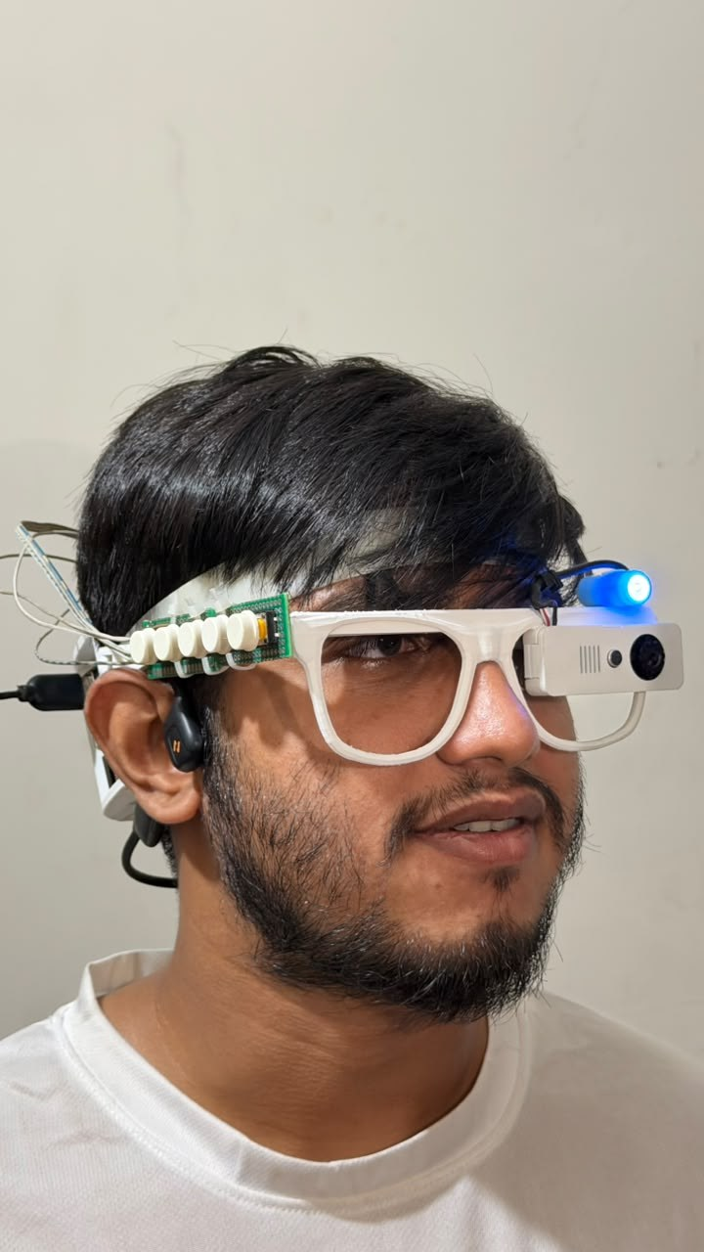

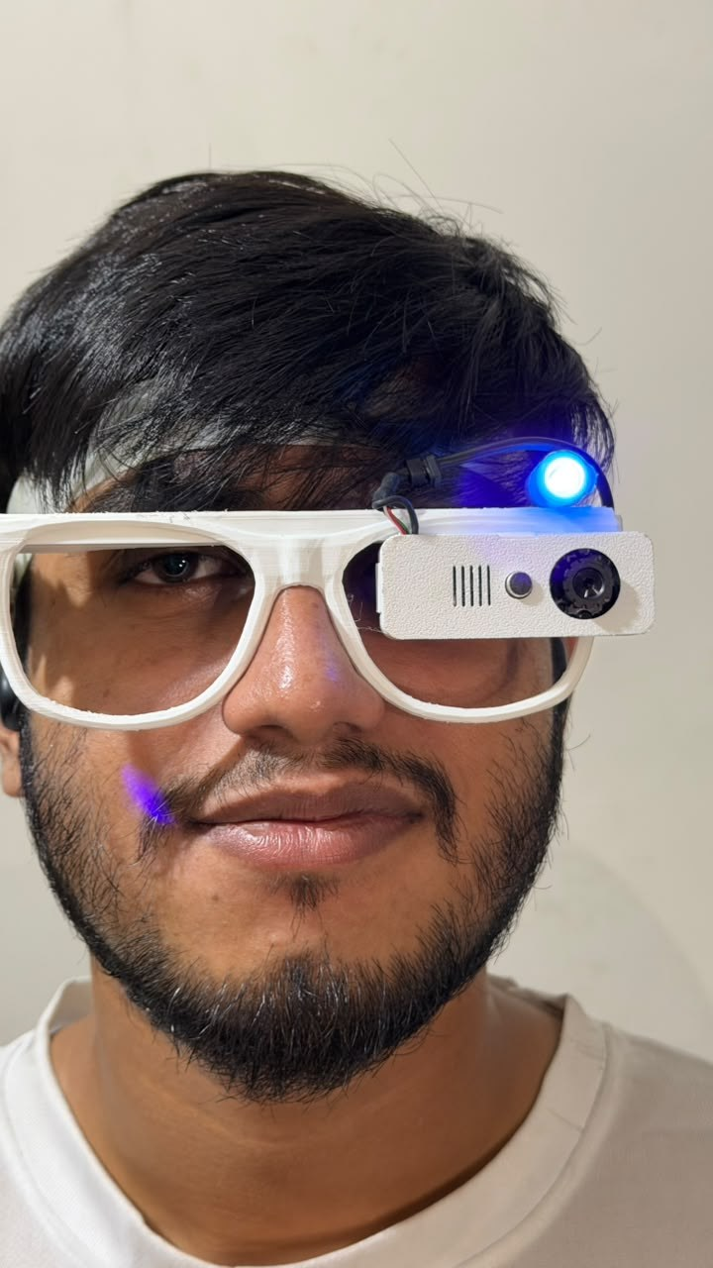
Testing the worn glass
First field test
With the glass camera, currency was unreliable and Bangla text was not read; we suspect the 640×480 fixed-focus picture.
User trials
Sessions with a visually impaired participant have started; a Bangla voice questionnaire records answers.
Prototype version 2 on team members: fit, weight and button reach are checked before user trials.
Notes:
The second prototype on team members. The first field test with the glass camera was not good enough: currency was unreliable and Bangla text was not read, probably because of the low-resolution fixed-focus camera. User trials have started and will add the survey results.

Slide 22


Limitations and next steps
Better glass camera
Higher resolution or autofocus; a test set taken through the glass
Complete the user study
8–12 participants: task time, accuracy, SUS and NASA-TLX
More counterfeit prints
About 100 unseen prints with a bank or the police; UV check on real counterfeits
People's voices, Bangla commands
Commands spoken by people into the glass; an offline Bangla recogniser
Faster, cooler Pi
Time the new code on the Pi; better cooling; battery life
Notes:
Our next steps: a better glass camera, completing the user study, more counterfeit prints, testing voice commands with people and Bangla command words, and timing and cooling the new code on the Pi.

Slide 23
Thank you
Questions are welcome
An offline glass that speaks Bangla, reads text, names objects and recognises Taka on a Raspberry Pi 5
New methods: prefix training, a safe verdict, the DMWR watermark checker, hand-held fine-tuning
Next: a better camera and the user trials
Notes:
To sum up: an assistive glass that speaks Bangla and runs on a Raspberry Pi 5, tested part by part on held-out data, with new methods for counterfeit checking and hand-held notes. Thank you; we are happy to take questions.

Slide 24
References
[1] World Health Organization. Blindness and vision impairment: fact sheet, 2023.
[2] OrCam Technologies. OrCam MyEye.
[3] Ali A., H. et al. A Google Glass based real-time scene analysis for the visually impaired. IEEE Access 9, 2021.
[4] Brilli, D. D. et al. AIris: an AI-powered wearable assistive device for the visually impaired. arXiv:2405.07606, 2024.
[5] Baek, Y. et al. Character region awareness for text detection (CRAFT). CVPR, 2019.
[6] JaidedAI. EasyOCR: ready-to-use OCR with 80+ languages.
[7] Jocher, G., Chaurasia, A., Qiu, J. Ultralytics YOLOv8.
[8] Lin, T.-Y. et al. Microsoft COCO: common objects in context. ECCV, 2014.
[9] Li, S., Deng, W., Du, J. Reliable crowdsourcing and deep locality-preserving learning for expression recognition in the wild (RAF-DB). CVPR, 2017.
[10] Rhasspy. Piper: a fast, local neural text-to-speech system.
[11] eSpeak NG text-to-speech.
[12] A diverse image dataset for Bangladeshi currency recognition (BanglaTaka). Mendeley Data.
[13] Rafi, M. J. A., Rony, M., Majadi, N. NSTU-BDTAKA: an open dataset for Bangladeshi paper currency detection and recognition. Data in Brief 55, 2024.
[14] Piyas, B. R. C. et al. JaalTaka: a benchmark dataset for detecting counterfeit Bangladeshi banknotes. Mendeley Data V2, 2025.
[15] Piyas, B. R. C. et al. JaalTaka: a benchmark dataset for detecting counterfeit Bangladeshi banknotes. Data in Brief 64, 112377, 2026.
[16] Uddin, M. S., Das, P. P., Roney, M. S. A. Image-based approach for the detection of counterfeit banknotes of Bangladesh. ICIEV, 2016.
[17] Pathak, A. et al. Enhanced counterfeit detection of Bangladesh currency through convolutional neural networks. IJIRCST 12(2), 2024.
[18] Sandler, M. et al. MobileNetV2: inverted residuals and linear bottlenecks. CVPR, 2018.
[19] Chowdhury, A. A. et al. Evaluation of deep learning models on UV ink: a fake money detection scheme with RPN. ICCA (ACM), 2022.
[20] Mutanen, J., Jaaskelainen, T., Parkkinen, J. P. S. Luminescent security properties of banknotes. IS&T PICS Conference, 2003, pp. 421-424.
[21] Nayef, N. et al. ICDAR2019 robust reading challenge on multi-lingual scene text (RRC-MLT-2019). ICDAR, 2019.
[22] Alpha Cephei. Vosk offline speech recognition toolkit.
[23] Piczak, K. J. ESC: dataset for environmental sound classification. ACM Multimedia, 2015.
Notes:
The sources cited on the slides, numbered as in the slides.

Slide 25



Links
Our code and results
Datasets
Open-source tools
SARA: glass software for the Raspberry Pi 5
github.com/aflam330/SARA
Research repository: experiments, results, thesis
github.com/aflam330/Senior_project_wearable_glass_for_blind_people_using_ocr_and_ylo
JaalTaka (counterfeit notes)
data.mendeley.com/datasets/2m7wk5cy4c/2
BanglaTaka (note photos)
data.mendeley.com/datasets/3cv2sypkkh/1
NSTU-BDTAKA (hand-held notes)
www.sciencedirect.com/science/article/pii/S2352340924006681
Microsoft COCO
cocodataset.org
ICDAR 2019 MLT
rrc.cvc.uab.es/?ch=15
ESC-50 environmental sounds
github.com/karolpiczak/ESC-50
Ultralytics YOLOv8
github.com/ultralytics/ultralytics
EasyOCR
github.com/JaidedAI/EasyOCR
Piper text-to-speech
github.com/rhasspy/piper
Vosk speech recognition
alphacephei.com/vosk/
eSpeak NG
github.com/espeak-ng/espeak-ng
WHO vision fact sheet
www.who.int/news-room/fact-sheets/detail/blindness-and-visual-impairment
Notes:
Our code is public on GitHub: the glass software and the research repository with every experiment. The datasets and open-source tools we used are linked here.

